Slide 2
Roundtable: Become a
Super Salesperson in Retail Ground Transportation
Moderators:
Moe Bouayad of Crown Worldwide
Karl Guenther of Statement Limousine
Doug Schwartz of Executive Ground Transportation
AV Sponsor
Coffee Sponsor

Slide 3
Welcome & Thank You to Our Sponsors
AV Sponsor
Coffee Sponsors

Slide 4
Question #1
What advanced sales techniques have you implemented to create deeper customer engagement in the highly competitive retail ground transportation market, and how do you tailor these strategies for different client profiles?
AV Sponsor

Slide 5
Question #2
In an industry where differentiation is key, how do you position your ground transportation services as the ideal solution for your clients' unique challenges, and what has been your biggest breakthrough in standing out from competitors?
AV Sponsor

Slide 6
Question #3
You receive a call from a potential wedding client looking to transport 50 guests. It's a significant opportunity, but several of your larger vehicles are already booked for other events. Given the importance of this day for the couple, they expect nothing less than flawless service, and you are determined to meet their needs despite the current booking challenges. How?
AV Sponsor

Slide 7
Question #4
Have you explored strategic partnerships with other businesses or service providers to enhance your value proposition? If so, what types of partnerships have yielded the highest ROI in terms of client acquisition and brand elevation?
AV Sponsor

Slide 8
Question #5
How do you balance the need for competitive pricing with maintaining a perception of premium value in the eyes of your clients?
What pricing strategies have you implemented to ensure profitability without compromising on service quality?
AV Sponsor

Slide 9
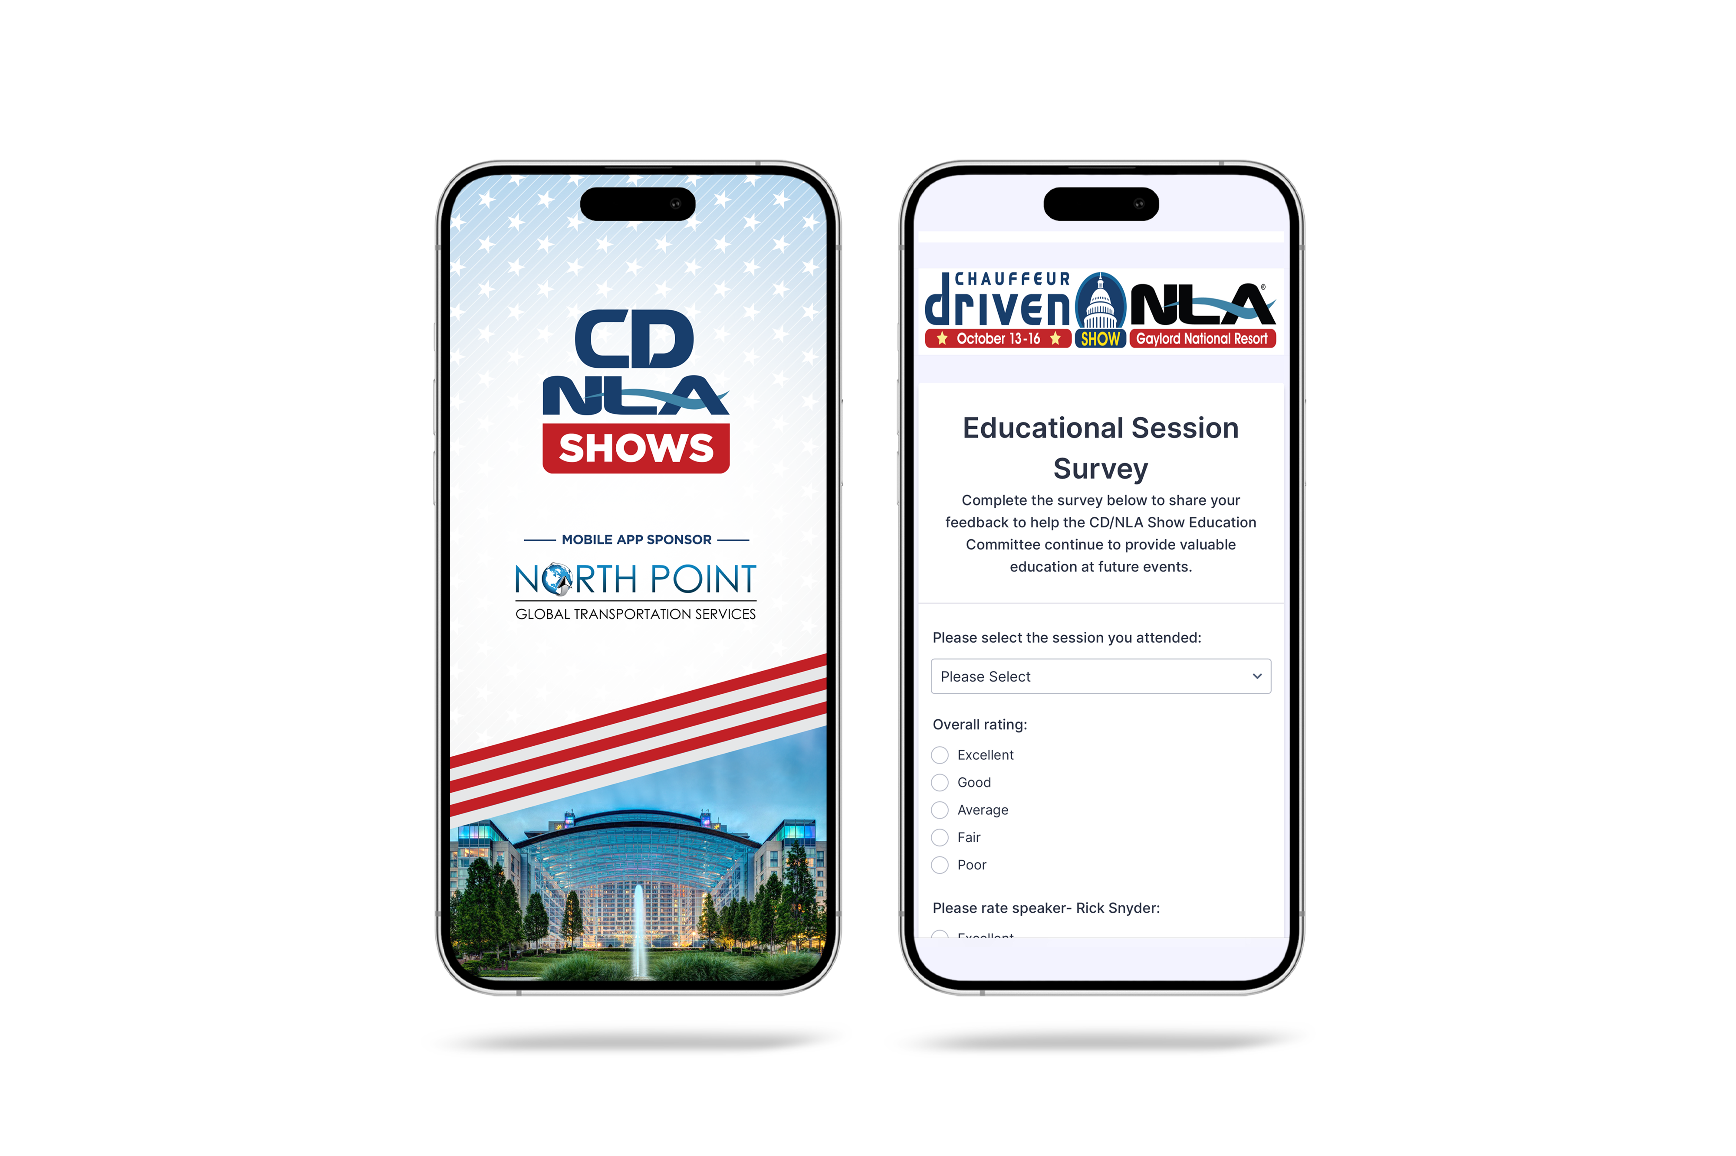
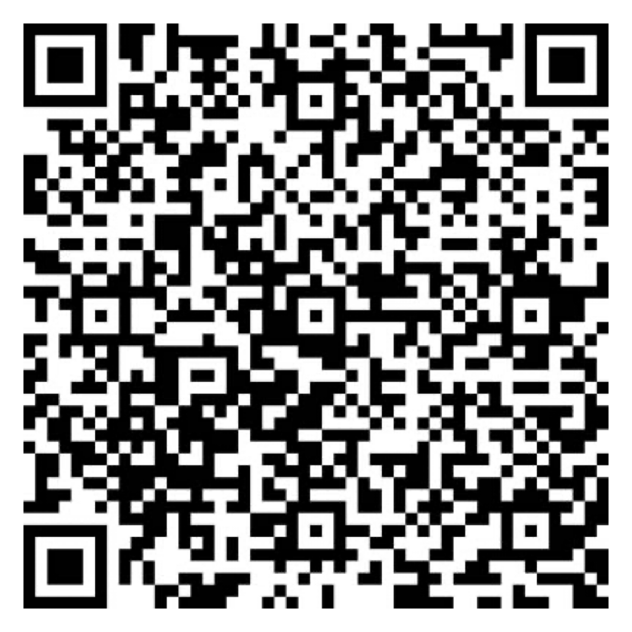
Let Us Know How
We Did!
Fill Out the Survey
AV Sponsor
Coffee Sponsor

Slide 10
Thank You for Joining Us!
AV Sponsor
Coffee Sponsor

